Slide 1

Ironhack:Comprehensive Review
Alex Husiev
Anna Snizhko
Gopika
Guadalupe Agüero Solis

Slide 2
Agenda
Ironhack's Ratings
Sentiment Analysis
Badges and Unique Selling Points
Geographic Reach and Locations
Pricing Strategy
Dashboard
Strengths and Weaknesses
Recommendations
Roadmap & Conclusion
Problem Statement & Goal
Course Offerings

Slide 3
Problem Statement & Goal
“The objective of this analysis is to comprehensively evaluate Ironhack's position in the market, identifying its strengths and weaknesses compared to competitors based on data scraped from SwitchUp.com*”
The goal is to provide actionable recommendations for enhancement and improvement through in-depth analysis & visual aid.
*Link to SwitchUp

Slide 4


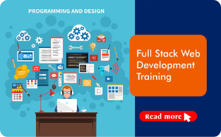
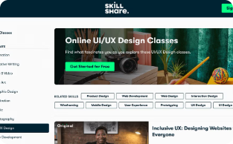
Course Offerings
Cyber Security
Data Analytics
Web Development
UX/UI Design
Ironhack's cyber security course equips students with the skills to protect networks and data from cyber threats, a critical skill in today's digital landscape.
The data analytics program at Ironhack teaches students to extract insights from data, a highly sought-after skill across industries.
Ironhack's web development course equips students with the skills to build modern, responsive websites and web applications.
The UX/UI design program at Ironhack focuses on creating intuitive and visually appealing user experiences, a critical component of successful digital products.

Slide 5
Ironhack Ratings vs. Competitors
Ironhack Overall score 4.71 out of 5
Overall rating 4.77
Curriculum Rating 4.58
Job Support Rating 4.51
Ironhack's Strong
Performance
Competitor
Performance
Overall rating 4-4.7
Curriculum Rating 4-4.6
Job Support Rating 4-4.5
- Le Wagon
- Springboard
- SheCodes
- DesignLab

Slide 6


Sentiment Analysis
Positive Feedback (+)
Highlights the quality of instruction and the comprehensive curriculum at Ironhack.
Negative Feedback (-)
Frequently mentions the need for improved job support services.

Slide 7



Badges & USP
Available Online
Verified Outcomes
Flexible Classes
Ironhack's online offerings provide global accessibility.
Ironhack's outcomes are verified, ensuring quality and transparency.
Ironhack offers flexible class schedules to accommodate
student needs.

Slide 8
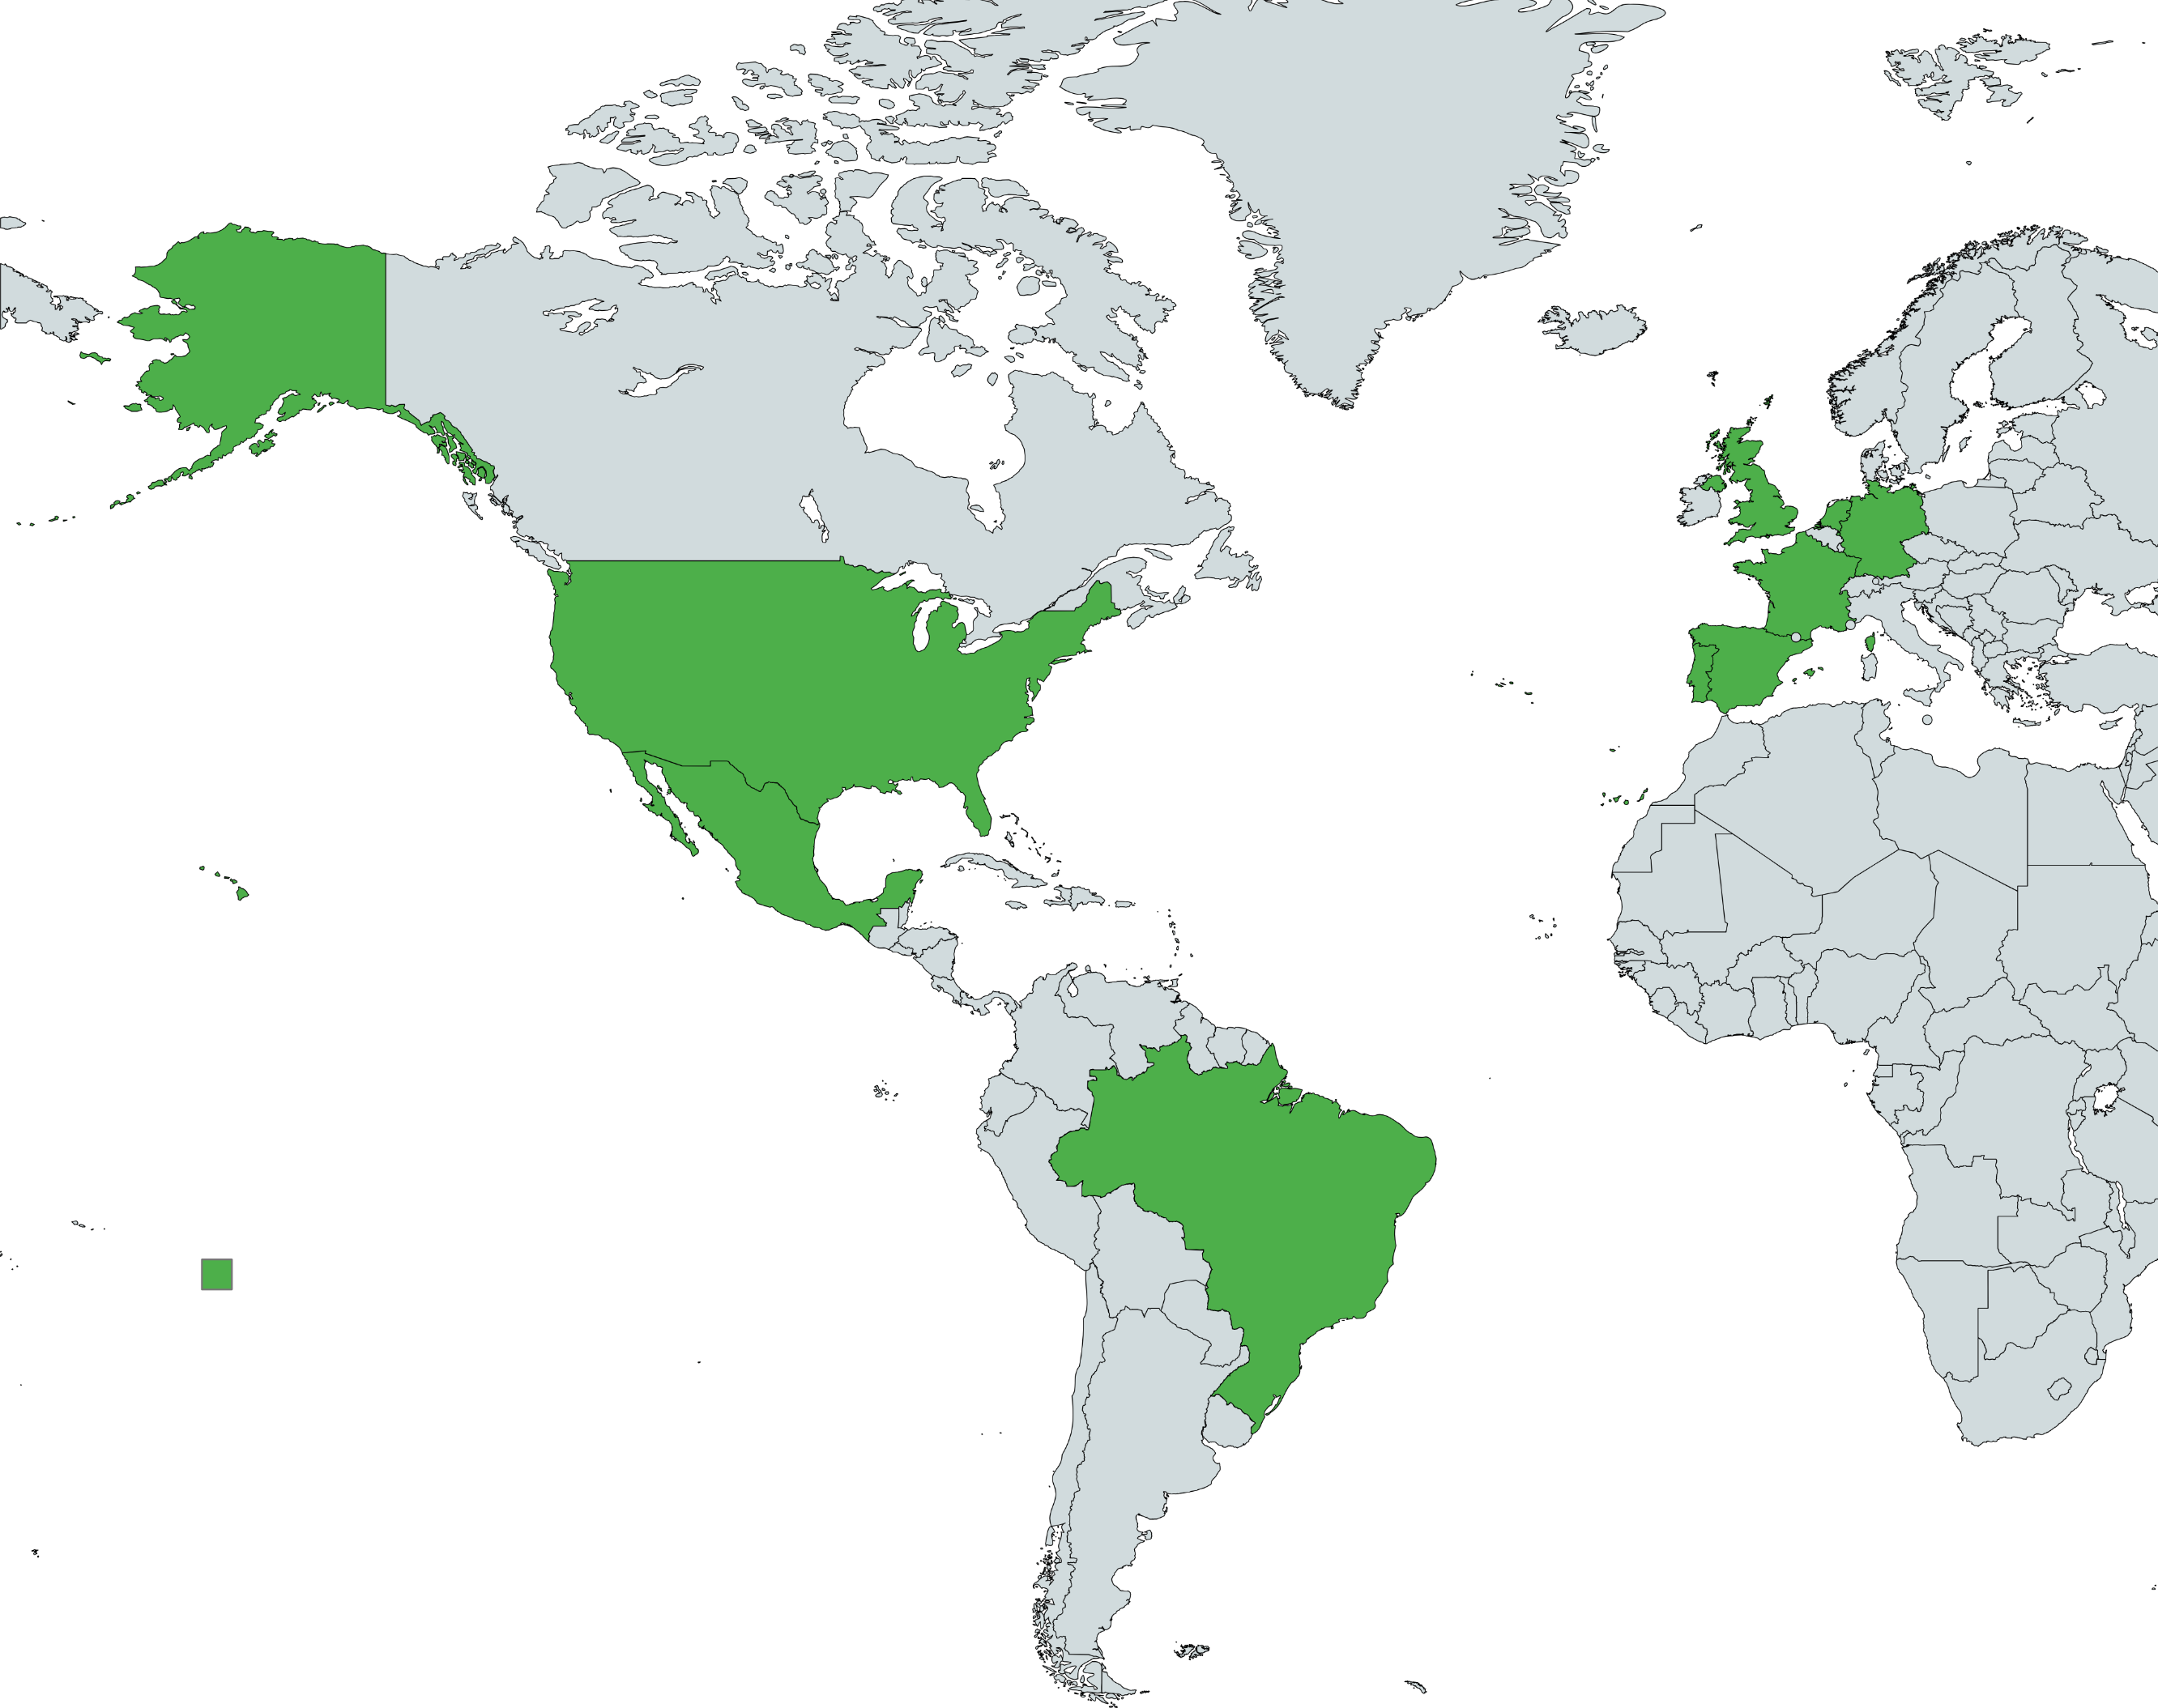
Geographic Reach & Locations
International Presence
Ironhack has a robust global footprint with campuses in key cities like Berlin, Mexico City, Amsterdam, Sao Paulo, and Paris.
Competitor Locations
Competitors like Springboard operate entirely online, while others like LearningFuze and Actualize have a more regional focus.
Expansion Opportunities
Ironhack can explore new potential locations, particularly in emerging tech hubs in Asia and the Middle East, to further expand its reach.

Slide 9



Pricing Strategy
Course Providers | Cost
Ironhack | $7,500 - $13,000
Springboard | $349 - $9,900
LearningFuze | Free intro, up to $15,995
Actualize | $16,900
Clarusway | $750 - $21,500

Slide 10

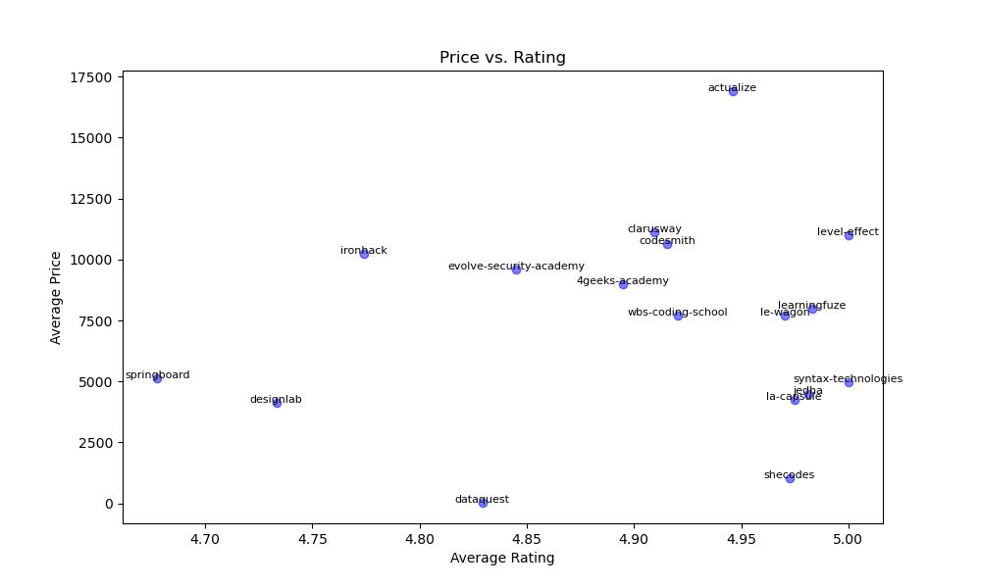
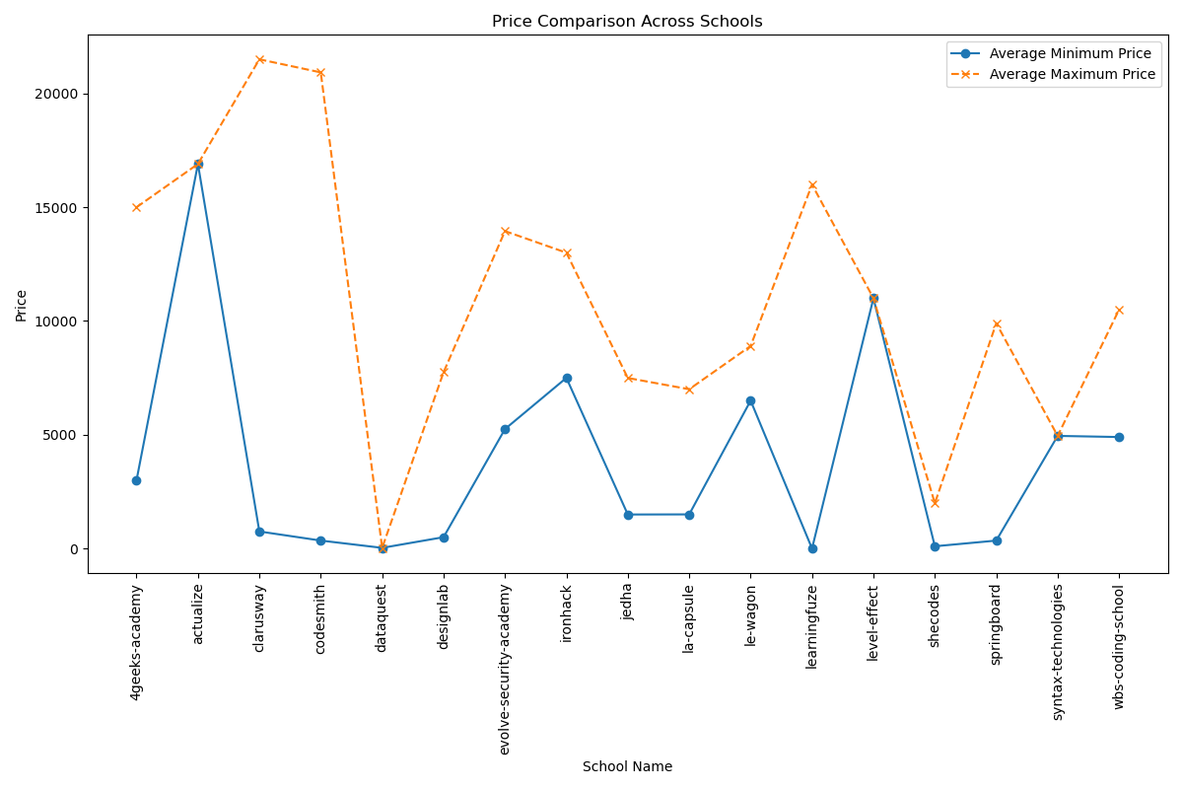
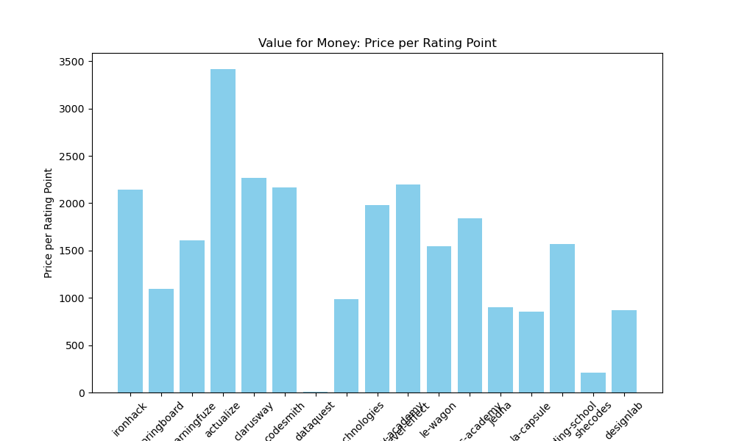
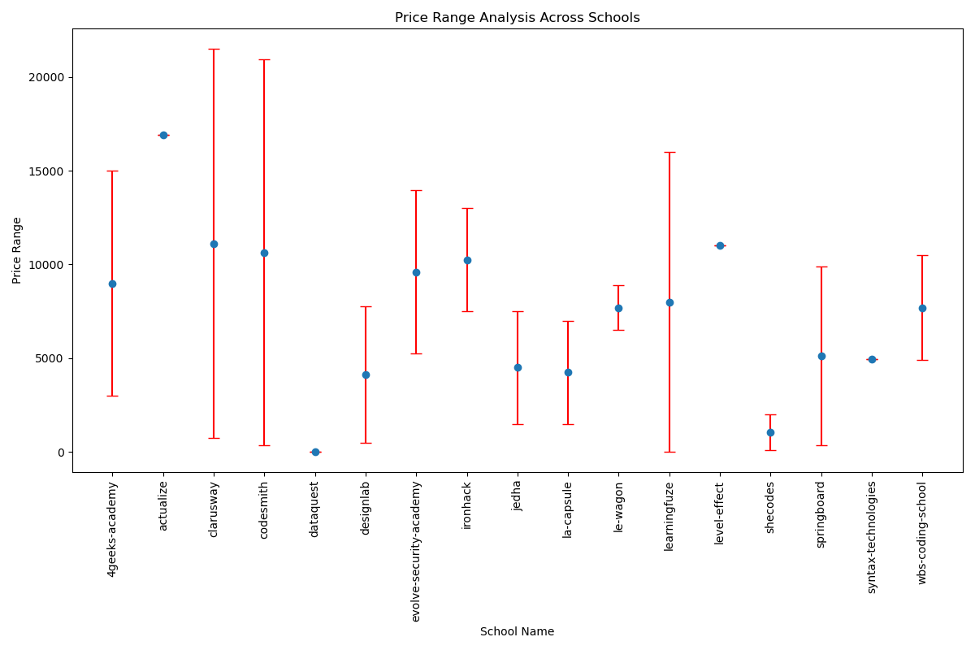
Dashboard - Pricing

Slide 11
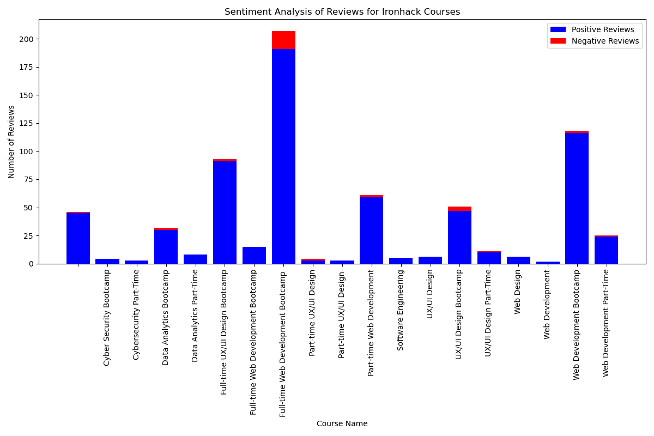
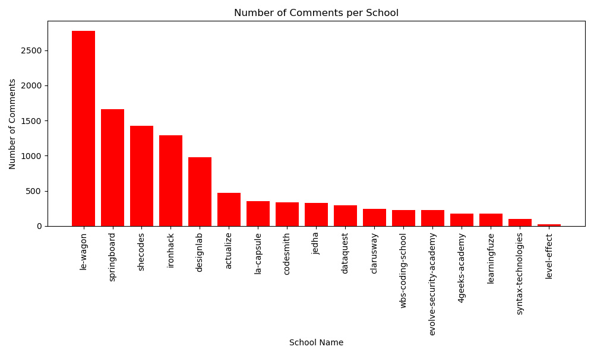
Dashboard – Comments & Sentiment

Slide 12
Sentiment Analysis
Ironhack's overall rating and score are competitive
Job support rating is strong compared to some competitors.
Ironhack's curriculum rating is lower than top competitors
average ratings are slightly below the highest tier.
Many geographic locations with remote classes are still open to tap
Artificial Intelligence
Automation
Macroeconomic conditions
S
W
O
T

Slide 13
Recommendations
Curriculum Improvement:
Focus on gathering feedback to enhance the curriculum and incorporate more in-demand skills and technologies.
1
Job Support Enhancement:
Offer more personalized career coaching, expand hiring partner networks, and host more job fairs and networking events.
2
Expand Course Catalog:
Introduce courses in emerging technologies like AI, ML, and Blockchain to cater to growing industry demands.
3
Flexible Payment Options:
Offer income share agreements, deferred tuition plans, and scholarships to make education more accessible.
4

Slide 14


Roadmap
Expand Regional Focus (Q1 2026)
Tech hubs in Asia and Middle east
Optimize Pricing Structure (Q4 2025)
Flexible payment options, Scholorships
Develop Pathways Program (Q2 2025)
Agreements with universities
Leverage Alumni Network (Q1 2025)
Engage alumni as ambassadors
Enhance Online
Presence (Q3 2024)
Online brand and digital marketing

Slide 15





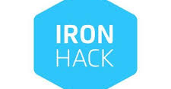
Conclusion
Ironhack is in a strong position with
diverse course offerings,
an international presence,
and recognized badges.
To further enhance its competitive edge, Ironhack should consider
expanding its curriculum,
improving job support services,
pursuing additional badges,
strategically expanding its geographic reach,and offering more flexible financial options.

